Slide 1
Digital Portfolio
STUDENT NAME: DHISVITH P
REGISTER NO AND NMID: 37124U09002
DEPARTMENT: BCA
COLLEGE: COLLEGE/ UNIVERSITY:
SRI AANDAL ARTS AND SCIENCE FOR WOMEN
THIRUVALLUVAR UNIVERSITY

Slide 2
PROJECT TITLE
“AI-Powered Chatbot for Customer Support”

Slide 3


AGENDA
Problem Statement
Project Overview
End Users
Tools and Technologies
Portfolio design and Layout
Features and Functionality
Results and Screenshots
Conclusion
Github Link
3/21/2024 Annual Review

Slide 4

PROBLEM STATEMENT
A general template for writing problem statements (for research, projects, or business cases).A problem statement for software development (like defining requirements or scope).A problem statement for academic research (thesis, dissertation, or paper).A real-world issue turned into a problem statement (e.g., climate change, traffic congestion, customer churn).

Slide 5

PROJECT OVERVIEW
Project Overview Structure1. Project Title – The name of the project.2. Background / Context – Why the project is important and what problem it addresses.3. Objectives – The main goals the project aims to achieve.4. Scope – What the project will cover (and sometimes what it won’t).

Slide 6

WHO ARE THE END USERS?
Who faces the problem? – The people experiencing the issue your project solves.2. Who will use the solution? – The people who will operate the system, app, product, or service.3. Who benefits most? – The group whose work or life becomes easier, faster, or better.

Slide 7

TOOLS AND TECHNIQUES
These are the technologies, software, or hardware used to carry out the project.Software Tools: Programming languages (Python, Java, etc.), frameworks (Django, React), databases (MySQL, MongoDB).Hardware Tools: Sensors, IoT devices, servers, computers.Project Management Tools: Trello, Jira, MS Project, Asana.Design Tools: Figma, Canva, AutoCAD (depending on the project).

Slide 8
POTFOLIO DESIGN AND LAYOUT
1. Cover PageName, title (e.g., Software Developer, Designer, Data Analyst), and contact info.A tagline or short statement about who you are.2. About Me / ProfileA short bio: background, expertise, and career goals.Optional: a professional photo.
8

Slide 9
FEATURES AND FUNCTIONALITY
A software product (like an app, website, or tool)?A device (like a phone, wearable, or gadget)?A document (like a business plan, project proposal, or product spec)?

Slide 10
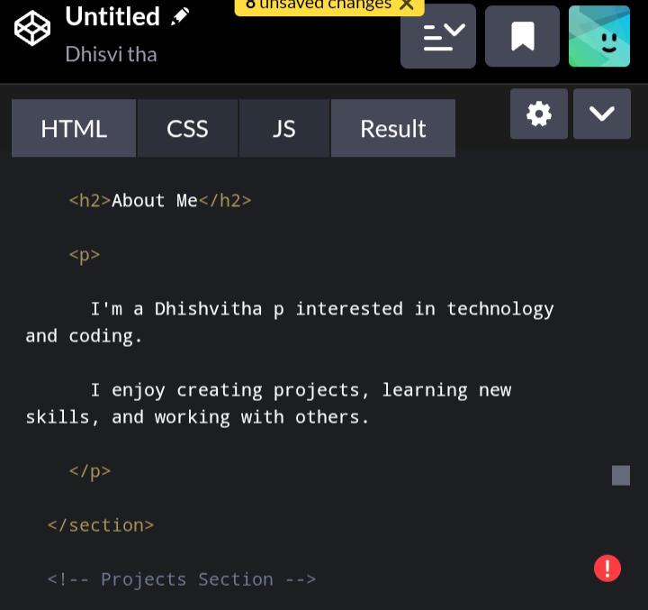

RESULTS AND SCREENSHOTS
3/21/2024 Annual Review
10

Slide 11
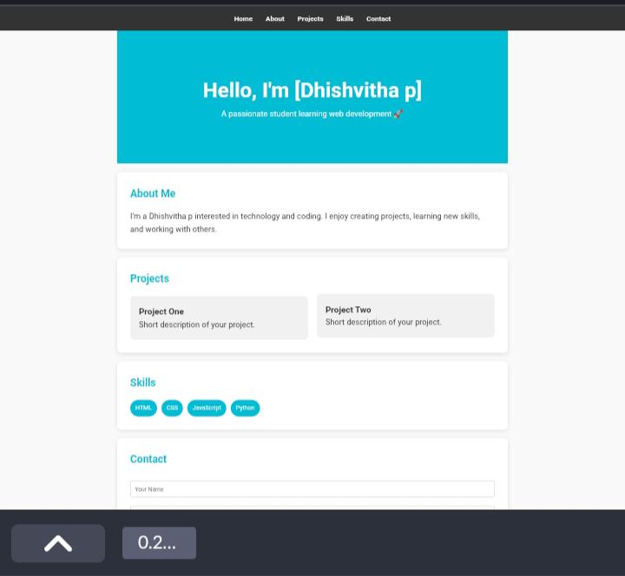

Slide 12
CONCLUSION
Summarize the key points discussed.Highlight the main findings, features, or outcomes.Emphasize the significance or value of what was presented.Provide closure and sometimes suggest next steps, recommendations, or a call to action.
12

